Slide 1
Understanding Ionization Efficiency from Sub-keV Nuclear Recoil Events in Direct Detection Dark Matter Experiments
Mitchell Matheny
University of Colorado Denver

Slide 2
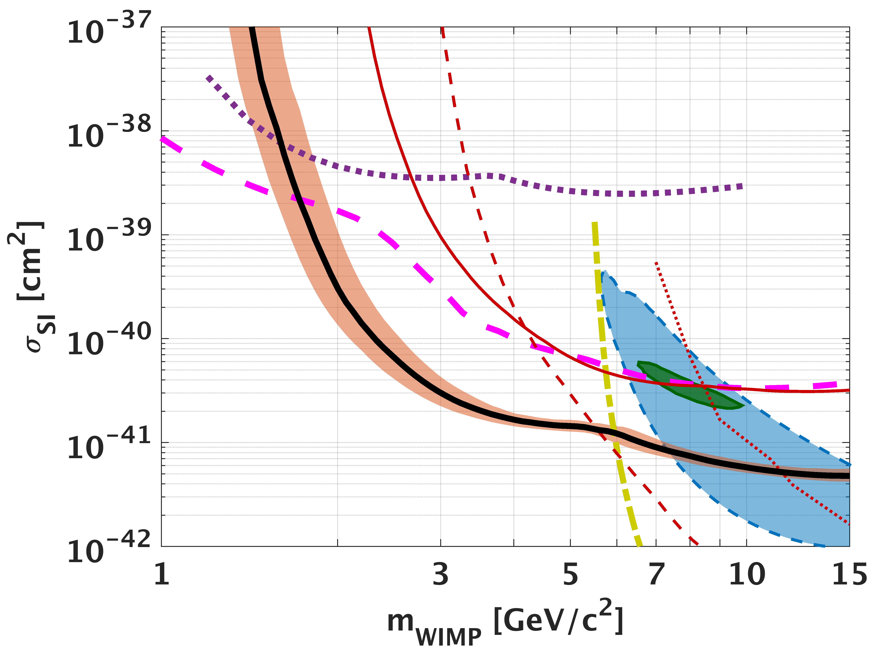
Dark Matter
Dark matter has been theorized to be Weakly Interact Massive Particles(WIMPs) with masses on the order of a GeV/c² to a few TeV/c^{2.}
In the post Minimal Supersymmetric Standard Model era, we are completely in the dark on the dark matter mass.
Dark matter can still be ”WIMP” like in the way it interacts with nuclei, but can have a very low mass.
Detectors that can measure electron-hole pairs have been moving the DM mass limit plot down.
CDMSlite
SuperCDMS
CRESST
LUX
R. Agnese, Et al. 2018
Notes:
CDMSlite phonon energy only.
We only know how to calibrate to Electron equivalent recoils, in order to determine the true nuclear recoil energy we need information about the ionization eff (yield)

Slide 3
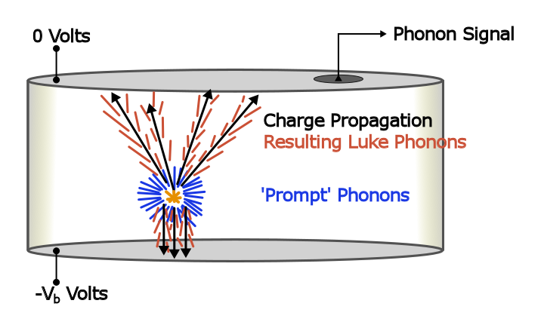


Charge Creation in Solids
When a WIMP hits nuclei initial phonons are produced and charge is liberated.
Current generation of low threshold detectors only count number of charge carriers produced.
There is no good nuclear recoil calibration standard.
Need to know ratio of energy that goes into the electronic system and its variation.
Or the best we could hope for is a distribution of the number of electron hole pairs for a given E_{r}
Notes:
A WIMP comes in a hits the nuclei, initial phonons are produced and charge is liberated in some ratio. Current generation of lowest threshold detectors only count the number of produced electron hole pairs. We do not have a good nuclear recoil calibration standard. Therefore to extract the nuclear recoil energy we have to know the ratio of recoil energy that goes into the electronic system.
Variation in energy given to the electronic system exists because a single E_r can create a spectrum of a possible number of electron hole pairs
Solid State detector with a voltage across it. For the purpose of this talk.

Slide 4
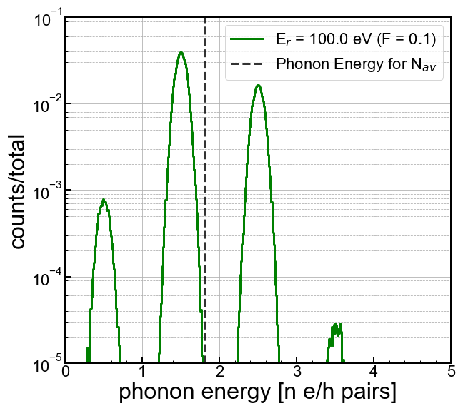
HVeV Detector.
A detector developed at Standford has developed a detector that can support 160V bias and a 14eV resolution.
Even with this high sensitivity they are still subject to randomness in electron hole pair production
Each peak represents a different number of electron hole pairs produced.
R.K. Romani, et al. 2017
Notes:
Citation for HVeV

Slide 5


Ionization Yield
Electron Recoils
The mean number of electron hole pairs produced varies greatly for electron recoils and nuclear recoils.
Measurements of charge and phonon would mean great discrimination between the two (far better than PSD and liquid scintillators)
This becomes difficult at low energy.
Nuclear Recoils
This makes the energy scale for nuclear
recoils nonlinear.
Notes:
A WIMP comes in a hits the nuclei, initial phonons are produced and charge is liberated in some ratio. Current generation of lowest threshold detectors only count the number of produced electron hole pairs. We do not have a good nuclear recoil calibration standard. Therefore to extract the nuclear recoil energy we have to know the ratio of recoil energy that goes into the electronic system.
Variation in energy given to the electronic system exists because a single E_r can create a spectrum of a possible number of electron hole pairs

Slide 6
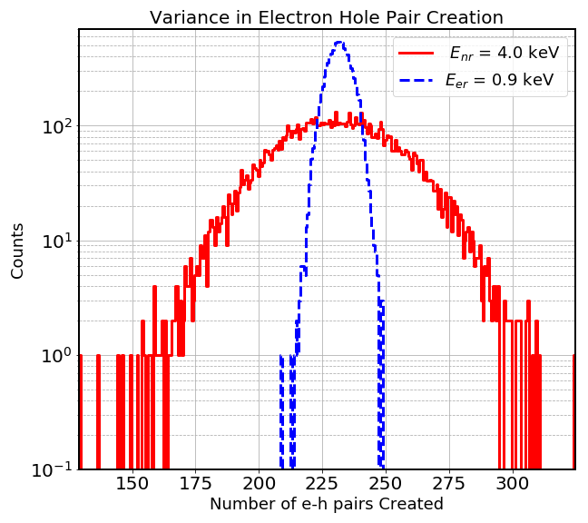
Variation in Electron Hole Pair Creation
Ratio of energy used to create electron-hole pairs to the energy used to create phonons.
The number of electron hole pairs produced varies for a single nuclear recoil energy.
This may play an important role with detectors that have single electron hole pair sensitivity .
Notes:
There is a variant number of electron hole pairs exists for a given Er for both electron recoils and nuclear recoils.

Slide 7
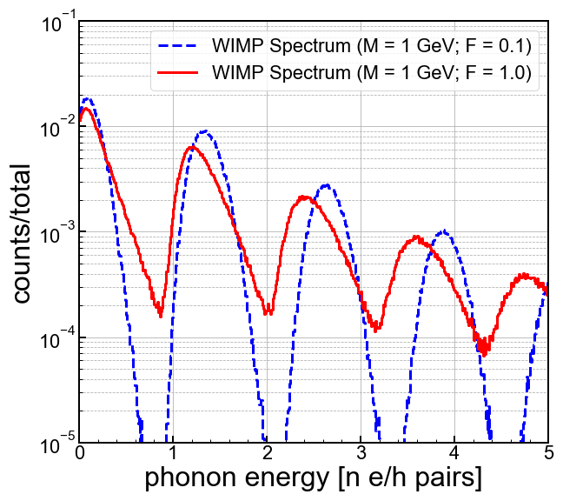
HVeV Detector.
Using Luke amp type detectors may have dramatic consequences for WIMP search.
Choice of fano factor can change limit set on WIMP cross section.
Notes:
Will talk more about it. Less bullet points.

Slide 8
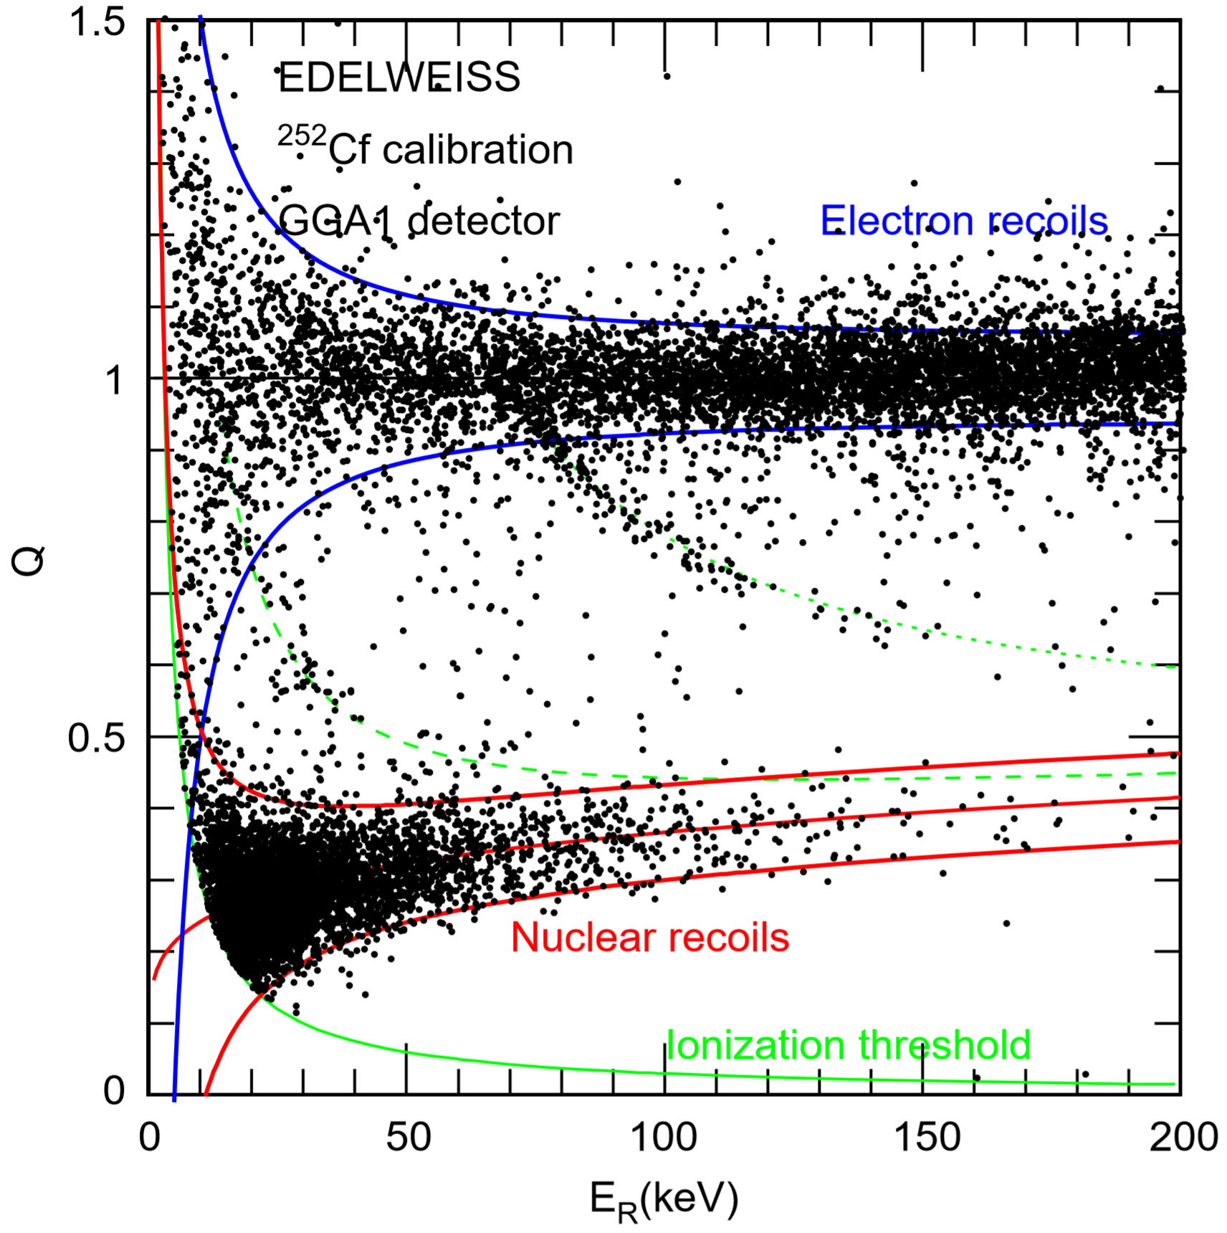
Quantifying Ionization Variance
Ability to directly to measure charge and phonons separately. Allowing for a direct measurement of the ionization efficiency.
Should be able to extract the width of the nuclear recoil band.
Allows quantify the variation in electron hole pair production.
Notes:
They can measure charge and phonons separately, this gives them a direct measure of the yield.

Slide 9
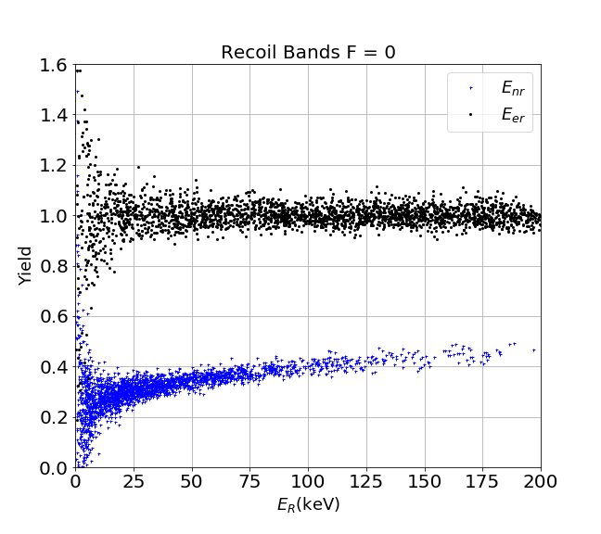
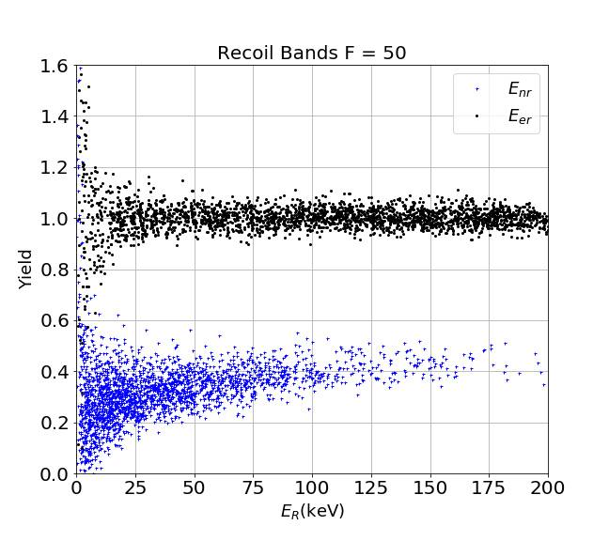
Quantifying Ionization Variance
Notes:
They can measure charge and phonons separately, this gives them a direct measure of the yield.

Slide 10
Quantifying Ionization Variance
Notes:
They can measure charge and phonons separately, this gives them a direct measure of the yield.

Slide 11
END
Notes:
Bands from data -> simulated bands. Side by side.

Slide 12

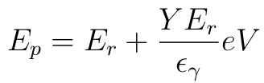
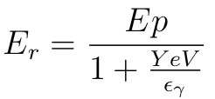
Recoil Energy Reconstruction CDMSlite
CDMSlite measures phonon energy (E_{p}) only.
Recoil energy is reconstructed using total phonon energy E_{p} and the contribution from Phonon amplification via Neganov-Trofimov-Luke effect E_{Luke}

Slide 13
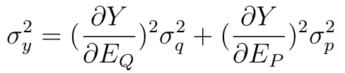
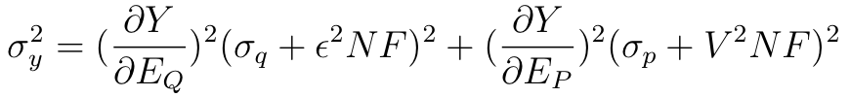
Yield Variance
The yield variance exists due to fact that for a given energy, nuclear recoils don’t produce the same amount of e-h pairs
This is not accounted for in current experiments.
This variation may be significant with new experiments with resolutions as low as 1 electron hole pair.

